Slide 1


Do Young People Still Prefer the Web? Revisiting Predictors of Survey Mode Preference
Kristen Olson
Jolene D. Smyth
University of Nebraska-Lincoln
JSM 2024
Portland, Oregon

Slide 2
What is mode preference?
Smyth, Olson, and Millar (2014) developed and tested a theory of mode preference using data from 2007/2008.
“A positive view toward participating in a particular mode” (Olson, Smyth, and Wood 2012)
This is different from “mode choice” (i.e., the mode a respondent selects when they have more than one option).
Notes:
Different from mode choice.

Slide 3
Today’s big questions
What covariates predict mode preference now?
Proxy measures of theoretical concepts
Direct measures of theoretical concepts
For those who prefer the web, what covariates predict a preference for answering on a computer versus a mobile device?
Is (predicted) mode preference associated with mode choice?
Including for a different survey

Slide 4
Past Research
Proxies for access and familiarity were the strongest predictors (e.g., age, internet access and use, preference for web to do other tasks, computer ability).
Education (a proxy for cognitive ability) was also a significant predictor.
External distractions were not strong predictors (e.g., married, children, employed), nor were trust measures (fear of viruses, scams, identity theft).
Predicted mode preference has increasingly been used for tailoring mode options in responsive and adaptive designs (e.g., Luiten and Schouten 2013; Jackson, et al. 2023; Zhang, et al. 2023).
Participation Mode
Mode access and familiarity
Cognitive Abilities
Stated Mode Preference
External Distractions
Trust & Legitimacy
Notes:
Note:
2008 NASIS was conducted as an RDD survey over the phone
2007 Lewiston-Clarkston Quality of Life Survey was conducted by web and mail

Slide 5
Data
Mode Preference Measurement
2022 Nebraska Annual Social Indicators Survey (NASIS)
Conducted by the Bureau of Sociological Research at UNL July 19, 2022 – November 16, 2022
Stratified random sample of 8,000 Nebraska residential addresses
Random selection of adult (age 19+) with next birthday in household
Concurrent mixed-mode design: web (38%) and mail (62%)
Three mailings
Invitation with $1 prepaid incentive
Postcard reminder
Full reminder mailing with incentive experiment (not analyzed here)
n=1,455, AAPOR RR2=18.2%

Slide 6
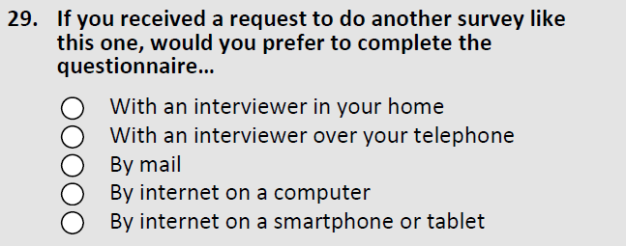
Dependent Variable: Stated Mode Preference
Notes:
In the past some have differentiated between landline and cellular, but we did not because we expected preference for telephone to be so low.
In the past people have not differentiated between computer and mobile device, but with the growth in availability and adoption of mobile devices and with design options like QR codes being of increasing interest, we felt it was important to do so.

Slide 7
Data (2)
Out-of-sample predictions
2023 Nebraska Annual Social Indicators Survey (NASIS)
Conducted by the Bureau of Sociological Research at UNL July 7, 2023 – October 15, 2023
Stratified random sample of 8,000 Nebraska residential addresses
Random selection of adult (age 19+) with next birthday in household
Concurrent mixed-mode design: web (26%) and mail (74%)
Three mailings
Invitation with incentive experiment (not analyzed here)
Postcard reminder
Full reminder mailing with incentive experiment (not analyzed here)
n=1,725, AAPOR RR2=22.6%
Use mode choice (web vs. mail) as a criterion variable to evaluate mode preferences

Slide 8
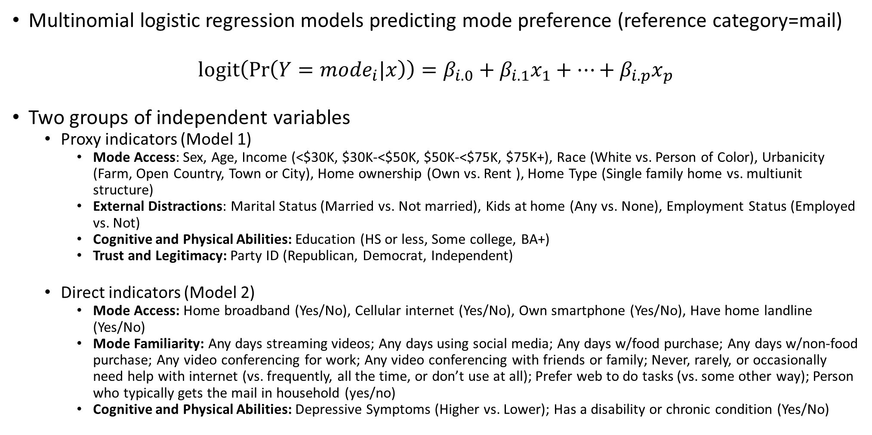
Analyses
Multinomial logistic regression models predicting mode preference (reference category=mail)
$$logit\left(\operatorname{Pr}\left(Y={mode}_{i}|x\right)\right)=β_{i.0}+β_{i.1}x_{1}+…+β_{i.p}x_{p}$$
Two groups of independent variables
Proxy indicators (Model 1)
Mode Access: Sex, Age, Income (<$30K, $30K-<$50K, $50K-<$75K, $75K+), Race (White vs. Person of Color), Urbanicity (Farm, Open Country, Town or City), Home ownership (Own vs. Rent ), Home Type (Single family home vs. multiunit structure)
External Distractions: Marital Status (Married vs. Not married), Kids at home (Any vs. None), Employment Status (Employed vs. Not)
Cognitive and Physical Abilities: Education (HS or less, Some college, BA+)
Trust and Legitimacy: Party ID (Republican, Democrat, Independent)
Direct indicators (Model 2)
Mode Access: Home broadband (Yes/No), Cellular internet (Yes/No), Own smartphone (Yes/No), Have home landline (Yes/No)
Mode Familiarity: Any days streaming videos; Any days using social media; Any days w/food purchase; Any days w/non-food purchase; Any video conferencing for work; Any video conferencing with friends or family; Never, rarely, or occasionally need help with internet (vs. frequently, all the time, or don’t use at all); Prefer web to do tasks (vs. some other way); Person who typically gets the mail in household (yes/no)
Cognitive and Physical Abilities: Depressive Symptoms (Higher vs. Lower); Has a disability or chronic condition (Yes/No)

Slide 9
Analyses
Missing data in 2022 are multiply imputed and all analyses account for complex survey design in Stata 17.1
Average marginal effects from multinomial logistic regression models predicting mode preference in NASIS 2022 operationalized as:
Interviewer, mail, or web
Interviewer, mail, computer web, mobile web
Two sets of models
Only using proxy indicators of theoretical concepts
Including both proxy indicators and direct indicators
Evaluate whether predicted mode preferences using proxy indicators that are commonly available across studies are associated with mode choice (web vs. mail)
Interpret Average Marginal Effects as the percentage point difference in the probability of the outcome between the focal group and the reference group of the independent variable.

Slide 10
Model 1: Proxy Measures Only

Slide 11
No differences in mode preferences between women and men for any modes other than computer web, which women prefer less than men.
Women are 7.9 pp less likely than men to prefer computer web.
*
*p<.05, **p<.01, ***p<.001, ****p<.0001

Slide 12
Older adults prefer mail and don’t prefer the web, and especially don’t prefer mobile.
****
*
****
*p<.05, **p<.01, ***p<.001, ****p<.0001

Slide 13
Older adults prefer mail and don’t prefer the web, and especially don’t prefer mobile. Younger people are more likely to report preferring web than mail, and among the web, have similar preferences between computer and mobile web.
Notes:
The differences by age get even more pronounced when we take other mode access and familiarity variables out of the model.
Age can be very helpful as a predictor if you don’t have more nuanced measures of internet dependability and speed, how often people do various tasks online, how many surveys of different types they do, whether they need help using the internet, and whether they prefer to use the web to do tasks that can be done other ways.

Slide 14
The highest income groups are more likely to prefer web than the lowest (<$30K) income group. The highest income group ($75K+) are less likely to prefer mail and more likely to prefer computer web.
***
*
*
*p<.05, **p<.01, ***p<.001, ****p<.0001

Slide 15
No differences in mode preferences between white adults and people of color, other than for overall web preferences.
**
*p<.05, **p<.01, ***p<.001, ****p<.0001

Slide 16
Compared to those who live on a farm, those who live in open country or a town or city are less likely to prefer mail and more likely to prefer web, especially computer web.
****
*p<.05, **p<.01, ***p<.001, ****p<.0001

Slide 17
Compared to those with a high school degree or less, those with a BA or higher are more likely to prefer web – including both computer web and mobile web – and less likely to prefer mail. There is no difference between those with some college and high school or less.
***
*p<.05, **p<.01, ***p<.001, ****p<.0001

Slide 18
Model 1: Other Proxy Measures
No differences in mode preferences for…
Mode access proxy measures
Renter vs. owner
Single family home vs. other type of housing unit
External distractions
Married vs. Not married
Kid at home vs. No kid at home
Employed vs. not employed
Trust and Legitimacy
Democrats vs. Republicans vs. Independents

Slide 19
Model 2: Proxy Measures and Direct Measures

Slide 20
Having broadband or cellular internet at home is not associated with mode preferences with one exception. Having cellular internet is associated with preferring interviewer-administered modes.
*p<.05, **p<.01, ***p<.001, ****p<.0001

Slide 21
Having a smartphone is associated with increased preferences for the web, especially computer web, and decreased preferences for mail. Landlines are associated with decreased preferences for interviewer-administered modes, but nothing else.
*p<.05, **p<.01, ***p<.001, ****p<.0001

Slide 22
Those who made non-food online purchases in the last month are much more likely to prefer web, especially computer web, and less likely to prefer mail.
****
*p<.05, **p<.01, ***p<.001, ****p<.0001

Slide 23
Those who never need help using the internet and prefer doing tasks online are much more likely to prefer web, especially computer web, and much less likely to prefer mail or interviewer-administered modes.
*p<.05, **p<.01, ***p<.001, ****p<.0001

Slide 24
Model 2: Direct Measures of Mode Familiarity
No differences in mode preferences for…
Any days streaming videos
Any days using social media
Any days w/food purchase
Any days video conferencing for work
Any video conferencing with friends or family
Person who gets the mail in household

Slide 25
Those with depressive symptoms are more likely to prefer the web; those with disabilities are more likely to prefer interviewer-administered modes.
*p<.05, **p<.01, ***p<.001, ****p<.0001; ++p<.01 on logit scale but not probability scale

Slide 26
Mode Access
Sex
Age
Income
Race
Urbanicity
Own vs. Rent Home
Home Type
_____________________
Home broadband
Cellular internet
Smartphone
Home landline
Mode Familiarity
Any days streaming videos
Any days using social media
Any days w/food purchase
Any days w/non-food purchase
Any days video conferencing for work
Any video conferencing with friends or family
Never need help with internet
Prefer web to do tasks
Person who gets the mail in household
External Distractions
Marital Status
Kids at Home
Employment Status
Cognitive Abilities
Education
Depressive Symptoms
Disability/Chronic Condition
Trust & Legitimacy of the Request
Party ID
Participation Mode
Stated Mode Preference
Notes:
Our independent variables are sets of indicators for mode access and familiarity, external distractions, cognitive abilities, and trust and legitimacy.
Items in Red are measures direct measures of the constructs; the white items are proxy measures.

Slide 27
Self-reported mode preferences are clearly related to (and endogenous to) participation mode. Almost nobody who said they preferred interviewer-administered or mail modes participated by web.

Slide 28
Predicted Probabilities of Mode Preferences
Obtain predicted probabilities of reporting a preference for interviewer, mail, or web modes from the proxy measures model (Model 1) for each of the three modes in NASIS 2022
Create deciles from predicted probabilities
Examine mean probabilities of preferring each mode; focus on web preference today
Examine web choice rate in each decile
Examine area under the receiver operating characteristic curve with mode selection as the outcome variable
Use coefficients from Model 1 in 2022 and apply to NASIS 2023 (out-of-sample predictions)
Repeat above steps

Slide 29
2022 Web preference deciles from Model 1 are associated with web selection rates, and best at predicting “not web.”
Area under the ROC = 0.760

Slide 30
2023 web preference deciles, using the 2022 Model 1 coefficients, are associated with web selection rates, and best at predicting “not web.”
Area under the ROC = 0.735

Slide 31
Summary
Adults can still report mode preferences, with about half reporting a preference for mail surveys and half reporting a preference for web surveys.
Mode access, mode familiarity, and cognitive and physical abilities predict self-reported mode preferences.
As in past research, measures of external distractions and trust and legitimacy proxies are not associated with mode preferences.
If the goal is to tailor modes to anticipated survey mode preferences:
Demographic measures that are associated with access to the internet and cognitive and physical abilities continue to be good predictors of mode preference.
And are associated with mode selection!
We could benefit from appending measures of these demographics to sample frames as well as consumer data about non-food purchases and measures of mode familiarity.
Notes:
In the past 15+ years, preference for web has increased and preference for mail has decreased so that now about 50% prefer each of these modes.
Demographic measures that are associated with access to and familiarity with the internet continue to be good predictors of mode preference.
These are measures we sometimes get on sample frames and so can use them to try to cater to mode preference.
They are items that are commonly measured in surveys and so should be available for use when evaluating mode measurement effects.

Slide 32
Limitations and Next Steps
Because this study was conducted via only mail and web, we have selected out the people who truly prefer interviewer administration.
But many surveys are only using mail and web these days.
Nebraskans may be different from other people.
But this is a general population cross-sectional probability-based survey, so likely to apply to many other situations.
Explore how well linked / merged indicators on the frame of these demographic variables predict mode preferences

Slide 33
Thank you!
kolson5@unl.edu
jsmyth2@unl.edu

Slide 34
No differences in mode preferences between women and men for any modes other than computer web, which women prefer less than men.

Slide 35
Web preference – and especially computer web preference - increases as income increases. Mail is the primary preferred mode for lower income adults.
Notes:
This is net of how satisfied they are with their finances.
The income effects also become more pronounced if you drop some of the more nuanced measures out of the model, indicating it can be a useful predictor if you don’t have those other predictors.

Slide 36
Why revisit mode preferences now?
A lot has changed in the last 15+ years
Technology:
Increased internet and smartphone adoption
Home internet now looks very different – dial up, broadband, satellite, cellular
People interact with the internet differently – computers, smartphones, tablets, game systems, TVs, etc.
Culture and Politics:
More communication and commerce now happens online (accelerated by COVID-19)
Increased attention to false information online
Disruptions to mail systems – delays, interruptions, political wrangling, threatened driver strikes

Slide 37
Mode Access
Sex
Age
Income
Race
Urbanicity
Own vs. Rent Home
Home Type
_____________________
Home broadband
Cellular internet
Smartphone
Home landline
Mode Familiarity
Any days streaming videos
Any days using social media
Any days w/food purchase
Any days w/non-food purchase
Any video conferencing for work
Any video conferencing with friends or family
Never need help with internet
Prefer web to do tasks
Person who gets the mail in household
External Distractions
Marital Status
Kids at Home
Employment Status
Cognitive Abilities
Education
Depressive Symptoms
Disability/Chronic Condition
Trust & Legitimacy of the Request
Party ID
Participation Mode
Stated Mode Preference
Notes:
Our independent variables are sets of indicators for mode access and familiarity, external distractions, cognitive abilities, and trust and legitimacy.
Items in Red are measures direct measures of the constructs; the white items are proxy measures.

